Slide 1
Employee Data Analysis using Excel
STUDENT NAME: ANCY JOSE
REGISTER NO: 4AEF487F9DC3E29BDCD4E90D458B22B4,312208642
DEPARTMENT: B.COM(GENERAL)
COLLEGE: MEENAKSHI COLLEGE FOR WOMEN

Slide 2
PROJECT TITLE
EMPLOYEE PERFORMANCE BASED ON GENDER AND EMPLOYEE RATING

Slide 3


AGENDA
Problem Statement
Project Overview
End Users
Our Solution and Proposition
Dataset Description
Modelling Approach
Results and Discussion
Conclusion
3/21/2024 Annual Review

Slide 4

PROBLEM STATEMENT
Employee performance evaluations typically focus on objective criteria related to job performance, such as productivity, quality of work, and teamwork. Employee performance based on gender requires careful consideration to ensure fairness and accuracy. It's important to recognize the potential for bias, and use the insights gained to promote a more equitable workplace.

Slide 5

PROJECT OVERVIEW
.
Employee analysis involves examining various aspects of the workforce to gain insights that can help in decision - making, improving efficiency, and enhancing employee satisfaction.

Slide 6

WHO ARE THE END USERS?
● HUMAN RESOURCE DEPARTMENTS
● MANAGEMENT AND LEADERSHIP
● TEAM LEADERS AND SUPERVISORS
● EMPLOYEES
● EXECUTIVE LEADERSHIP
● BUSINESS ANALYSTS
● RECRUITERS

Slide 7

OUR SOLUTION AND ITS VALUE PROPOSITION
SORTING- REMOVE VALUES
PIVOT TABLE - SUMMARY OF
EMPLOYEE PERFORMANCE
STACKED AREA CHART- FINAL REPORT

Slide 8
Dataset Description
● EMPLOYEE DATA SET- NAN MUDHALVAN PORTAL
EMPLOYEE ID- ALPHANUMERIC(TEXT)
NAME- ALPHABETICAL(TEXT)
GENDER- ALPHABETICAL(TEXT)
DEPARTMENT - ALPHABETICAL(TEXT)
SALARY - NUMERICAL START
DATE - ALPHANUMERIC(TEXT)
FTE- NUMERICALEMPLOYEE
TYPE- ALPHABETICAL(TEXT)
EMPLOYEE LOCATION- ALPHABETICAL(TEXT)
Current employee rating- NUMERICAL
Title-ALPHABETICAL(TEXT)
Business unit- ALPHABETICAL(TEXT)
Performance rate-numerical
Pay zone - ALPHABETICAL(TEXT)
Employee type- ALPHABETICAL(TEXT)
Employee status- ALPHABETICAL(TEXT)

Slide 9

THE "WOW" IN OUR SOLUTION
❖ This analysis helps in identifying and addressing biases. It helps to reduce discrimination and promote equal opportunities.
❖ It helps in promoting fairness and equality which further encourages to highlight discrepancies that need addressing to ensure fair treatment.
3/21/2024 Annual Review
9

Slide 10
MODELLING
● STEP -1
DOWNLOAD THE EMPLOYEE DATASET AND OPEN THE EMPLOYEE DATASET IN EXCEL.
● STEP -2
SELECT THE ENTIRE DATA AND CLICK ON DATA AND CLICK ON SORT OPTION.
● STEP -3
SORT FROM A TO Z ORDER.
● STEP -4
SELECT THE ENTIRE DATA AND CLICK ON INSERT AND CLICK ON PIVOT TABLE TO CREATE PIVOT TABLE.
● STEP -5
DRAG THE NEEDED DATA AND CREATE A PIVOT TABLE.
● STEP -6
SELECT THE PIVOT TABLE AND CLICK ON INSERT.
● STEP-7
NOW CLICK ON THE CHART THAT YOU WANT.
● STEP -8
THE CHART IS CREATED.
10

Slide 11

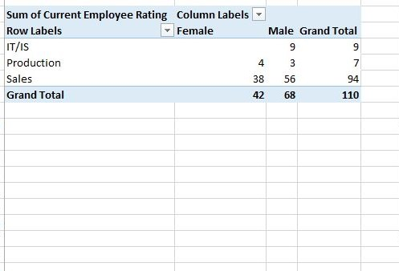
RESULTS
11

Slide 12
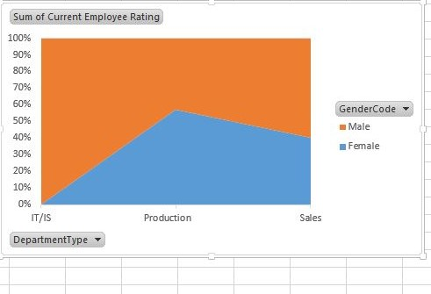
2.STACKED AREA CHART

Slide 13
conclusion
The dataset reveals the overall composition of the
workforce, including demographics such as gender,
salary, employee type and work location This
information is crucial for understanding the diversity
and experience level within the organization.
This analysis aids in addressing discrepancies prevailing in the organization and to mitigate potential biases and ensuring fair treatment of employees
Therefore this analysis is comprehensive, objective, and geared towards promoting fairness and equity in employee evaluations.

